Slide 1
Video Analytics, Redaction, and Your Agency
Craig D. Uchida and Clark Kimerer
Justice & Security Strategies, Inc.
Moderator: Eliot Harkavy, CNA
March 2018

Slide 2
Introductions
Eliot Harkavy, Moderator
Craig D. Uchida
Clark Kimerer

Slide 3
Overview
Video Analytics – What are they?
The State of Video Analytics
What types of footage should be flagged and tagged?
Video Redaction – What is it?
The State of Video Redaction
Automation Challenges
Available Options

Slide 4
Why Video Analytics?
Lots of video footage
Only video with “known content” will come to light

Slide 5
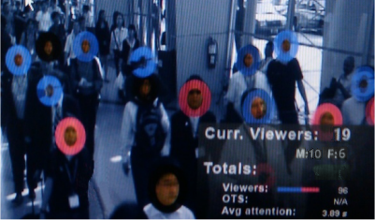
Why Video Analytics?
What about the other footage?
What are the hidden risks and/or advantages of the other footage?

Slide 6
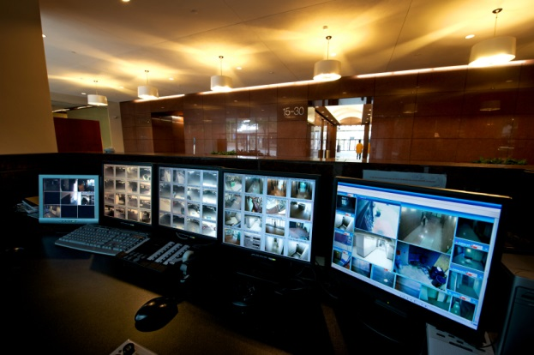
Why Video Analytics?
What do you want to categorize, tag or flag?
No need to tag the ‘big things’ – e.g. OIS or crimes in progress
But, what type of officer activities?
Incidents they forget to tag?
Audits?
Other behavior?

Slide 7
Why Video Analytics?
LAPD data --
Number of BWCs: 7,000
Number of videos per year: ___
Number of hours of video per year: ___

Slide 8
What are the issues?
BWC and CCTV footage
are similar and different
Similarities –
We look for ‘abnormal movement’ or individuals
Motion detection of people
Object recognition – faces, vehicles,
signs, etc.

Slide 9
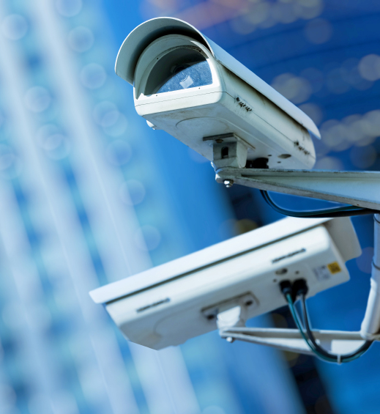
What are the issues?
But, Important differences:
CCTV – physical security –
across a city, in a mall, in a prison
Cameras are in fixed locations and are basically ‘still’
Reviews are done by sitting at a monitor

Slide 10
What are the issues?
BWCs – interactive – the camera and
person move
BWC - movement of the wearer effects the tools to analyze the footage
Why does this matter?

Slide 11
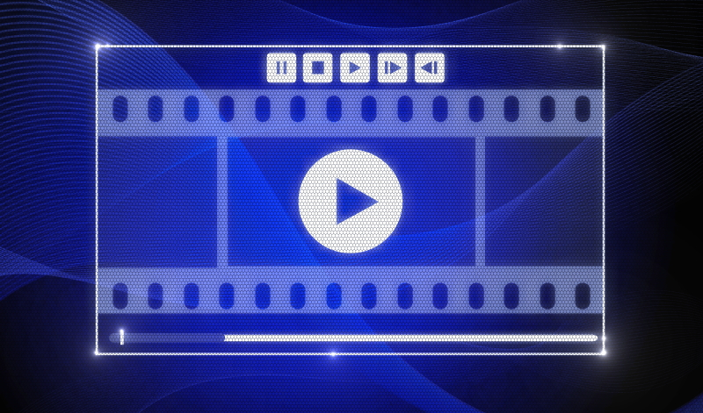
What are video analytics?
Analytics:
Allow us to ‘read’ video footage
Viewed as ‘data,’ footage is broken into different components – frames and pixels within the frames
Math allows us to determine commonalities or uniqueness in the footage

Slide 12
Challenges
BWCs present unique math challenges
Camera is in motion
Image quality (e.g., low light)
What other problems?
1000 different scenarios or ‘use cases’ and 1000 different algorithms
There is no ‘paint-by-numbers’
template

Slide 13
Challenges
Vendors and technologists are struggling with analytics
Meet them, talk with them, but don’t buy anything yet
Proofs of concept, tests, and trials are the best approaches
Work with them
All of this is still in its infancy

Slide 14
How do we proceed?
We should try to do a handful of things really, really well
Select scenarios or ‘use cases’
that you need for your purposes

Slide 15
How do we proceed?
LAPD example:
Invited technologists and vendors to show their stuff
90 minute presentations and Q&A
Provided them with footage and asked them to create algorithms for traffic stops, pedestrian stops, and pursuits
Tested their results by giving them 300 videos
Selected a vendor for more refinements

Slide 16
Anticipated video footage
Based on LAPD estimates –

Slide 17
What is Video Redaction?
The obscuring of pixels and/or audio within video to conceal information for security, legal or sensitive information purposes.
Process: Decode the video and process all the pixels through a computer, edit the video and then re-enter the video to disk again.

Slide 18
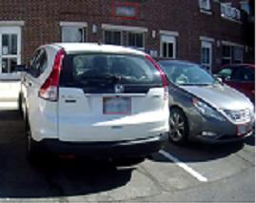
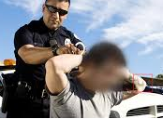
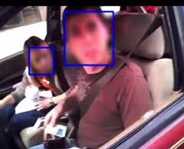
Why Video Redaction?
Legally required by some states/agencies
Protects witnesses, informants, victims, and minors identities
Protects PII information
FOIA requests

Slide 19
What are the issues?
Some agencies have abandoned BWCs due to state FOI laws and redaction costs.
Considerations include:
Costs (Manpower, time, software, storage)
Software requirements
Limited automation
Automation still requires human review
Notes:
Discuss Seattle hackathon and Bellingham

Slide 20
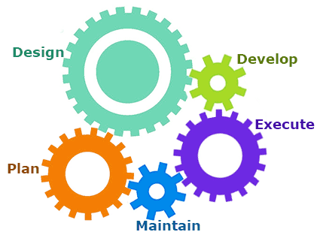
Automation Challenges
Understanding which items to redact in a scene requires human thinking.
Meta data auto tagging algorithms (Recognizing things in video is tough)
SD to HD video increases resolution and megapixels per frame
Redaction requirements vary per jurisdiction
Liability issues require human interaction
Software available to un-redact video
Notes:
https://www.linkedin.com/pulse/dont-believe-hype-behind-automated-video-redaction-software-varah

Slide 21
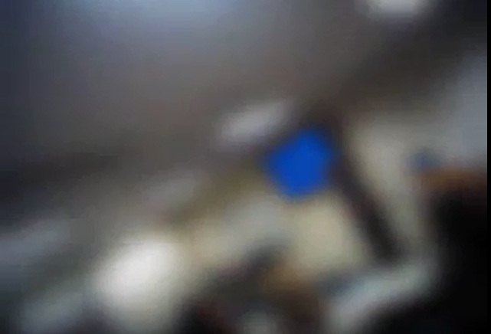
The State of Redaction
Types of Video Redaction currently offered:
Blurring entire frame
Notes:
Example: Seattle PD for full blurring and muting

Slide 22
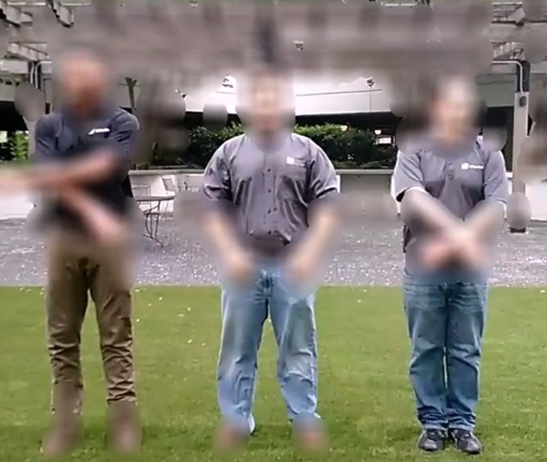
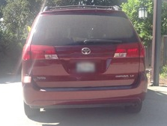
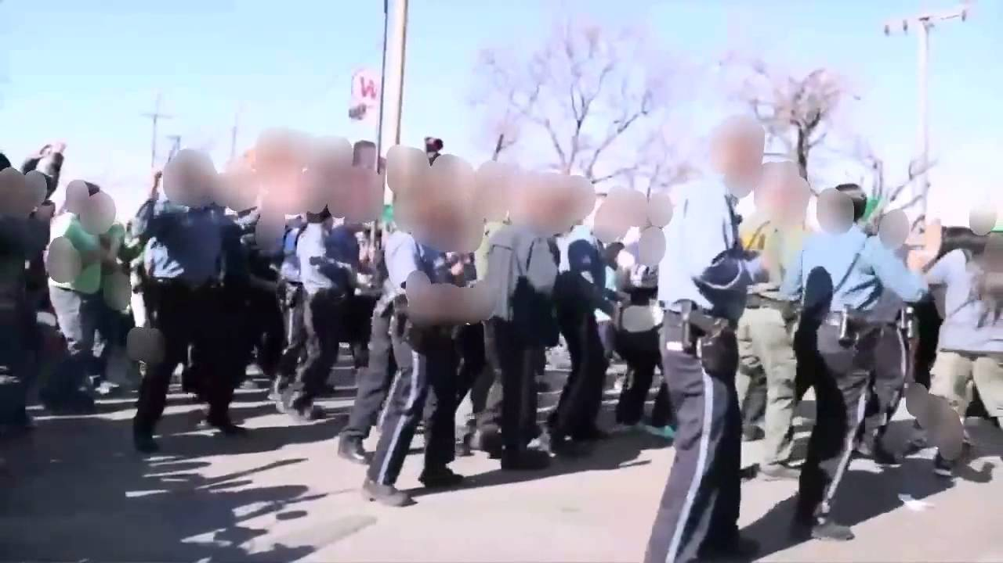
The State of Redaction
Blurring specific objects
Notes:
Example: Seattle PD for full blurring and muting

Slide 23
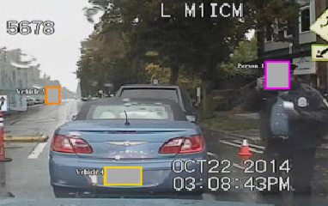
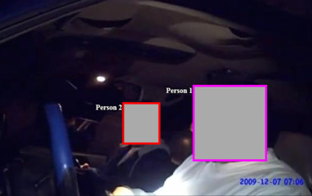
The State of Redaction
Blocking out specific objects
Notes:
Example: Seattle PD for full blurring and muting

Slide 24
The State of Redaction
Types of Audio Redaction Offered:
Muting of all audio
Selective Audio Redaction (mute/bleep)

Slide 25
Key Components
Able to redact audio & video
Authentication
Make sure you own the redacted video and meta data.
Security
Free trials online
Notes:
https://www.bja.gov/bwc/pdfs/BodyCameraExemptionRedactionGuidelines.pdf

Slide 26
Available Options to Assist
BWC Vendors - Examples- Not endorsements
Taser/Axon – Evidence.com Axon Suite & includes audio and video redaction with some automation.
Vievu – Automatic Video Redaction (AVR) includes audio and video redaction with some automation
Digital Ally –VuVault with redaction tools.
Utility –Smart Redaction & includes audio and video redaction with some automation.
Motorola – Digital Evidence Management Solution
Notes:
Most offer as redaction as part of digital Evidence Management offerings.
Taser/Axon – offers Digital Evidence Management (DEM) through Evidence.com Axon Suite & includes audio and video redaction with some automation in Microsoft Azure Government Cloud or on-premise.
Vievu – Automatic Video Redaction (AVR) includes audio and video redaction with some automation in Microsoft Azure Government Cloud or on-premise offering face or full body blurring.
Digital Ally – offers DEM through VuVault with redaction tools.
Utility – offers DEM through Smart Redaction & includes audio and video redaction with some automation.

Slide 27
Available Options to Assist
3rd-party software examples – Not Endorsements:
Adobe
CaseGuard – CaseGuard Studio offers audio & video redaction tools with some automation
MotionDSP – Ikena Spotlight offers audio & video redaction tools with some automation.
SoleraTec – Phoenix DEM
Getac – Veretos Enterprise Evidence Management
YouTube – FaceBlur
Notes:
Discuss movie editors like iMovie and Microsoft, etc., Apple Final Cut, GreyMeta, IBM

Slide 28
Available Options to Assist
Outsourcing Examples (Not Endorsements):
PRI Management: Cloud based service in Microsoft Azure Government cloud which is CJIS compliant. Upload video and request via webpage and get notification when done usually within a day unless high profile.
BlueSky Safeguard: Cloud based service video redaction service offering multiple different packages.

Slide 29
BWC Toolkit Resources:
Redaction Guidelines https://www.bja.gov/bwc/pdfs/BodyCameraExemptionRedactionGuidelines.pdf

Slide 30
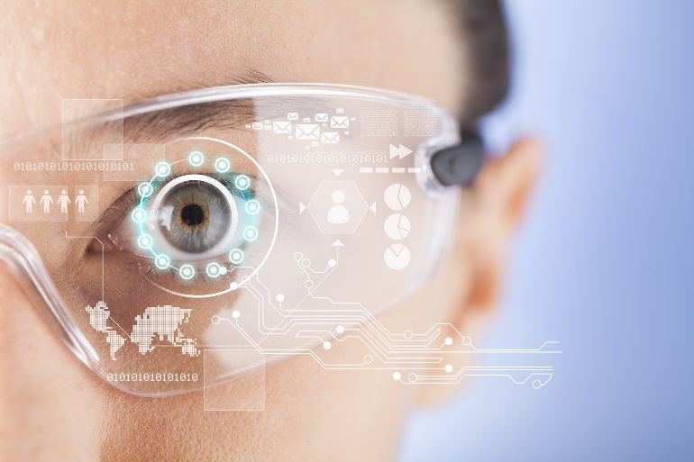
Future State of Redaction
Facial recognition cross-reference
Define similar incidents
Geotag correlation tools
Improved Auto-Tagging
Improved Auto-Redaction

Slide 31
Questions?

Slide 32
Contact Information
Craig D. Uchida
cduchida@jssinc.org
240-687-3719

